Slide 1
How can artificial intelligence help children communicate?
Carol Miller, PhD, Communication Sciences and Disorders
Suhas Bettapalli Nagaraj, doctoral student, Information Sciences & Technology
Jason Lucas, doctoral student, Information Sciences & Technology

Slide 2


FUNDED BY:
This material is based upon work supported under the AI Research Institutes program by National Science Foundation and the Institute of Education Sciences, U.S. Department of Education, through Award # 2229873 - AI Institute for Transforming Education for Children with Speech and Language Processing Challenges or National AI Institute for Exceptional Education. Any opinions, findings and conclusions or recommendations expressed in this material are those of the author(s) and do not necessarily reflect the views of the National Science Foundation, the Institute of Education Sciences, or the U.S. Department of Education.

Slide 3









Slide 4
Roadmap for today’s talk
Introductions
What is the problem in need of a solution?
What is AI...and what is it not?
Multimodal learning
Challenges of AI
What’s next?

Slide 5
Introductions
Carol Miller
Professor of Communication Sciences and Disorders and Linguistics
Member of the NSF & IES AI Institute for Exceptional Education
aka “AI4ExceptionalEd”
co-PI of NSF-funded Linguistic Diversity Across the Lifespan Graduate Research Traineeship Program
aka LinDiv
There are 25 NSF AI Institutes around the country!

Slide 6
Introductions
Suhas Bettapalli Nagaraj
Ph.D. Student in Informatics at Penn State
LinDiv NSF Research Traineeship Fellow
Research Focus
Machine Learning and Human-Computer Interaction for Healthcare
Education History
M.S. in Electrical Engineering (Signal Processing)
B.Tech in Electronics & Communications Engineering

Slide 7
Introductions
Jason Lucas
Ph.D. Candidate in Informatics at Penn State
LinDiv NSF Research Traineeship Fellow
Research Focus
AI for Cybersecurity, Public Health and Human Language Technology
Education History
M.Sc. in Computer Information System con. Health Informatics
MPH con. Epidemiology
B.Sc. in Information Technology

Slide 8
What’s the problem?
Children in need of speech and language services

Slide 9
Needs for treating S&L related disorders
1. About 80% of children with specific learning disability struggle with literacy and language (American Psychiatry Association, 2021) (~1.86M)
2. Speech or language impairment: all (~1.36M)
3. About half of the children under other health impairments have DLD (Mueller & Tomblin, 2012) (~0.55M)
Speech &Language related disorders affect more than ½ of students under IDEA, i.e., about 3.4M children.
Number of children in early childhood programs and of school age served under IDEA, Part B, by disability (Nov 2021) https://www2.ed.gov/programs/osepidea/618-data/static-tables/index.html

Slide 10

Challenge: providing quality S&L services
Children with speech and language disorders represent the largest intervention caseload¹.
3.4M* Need S&L services
60,900* SLPs at US Schools
CHALLENGE Which “evidence-based practice” should be used; and with what timing, intensity, duration?
*Department of Education, 2021
*Bureau of Labor Statistics, 2021
¹ASHA Schools Survey, 2020

Slide 11
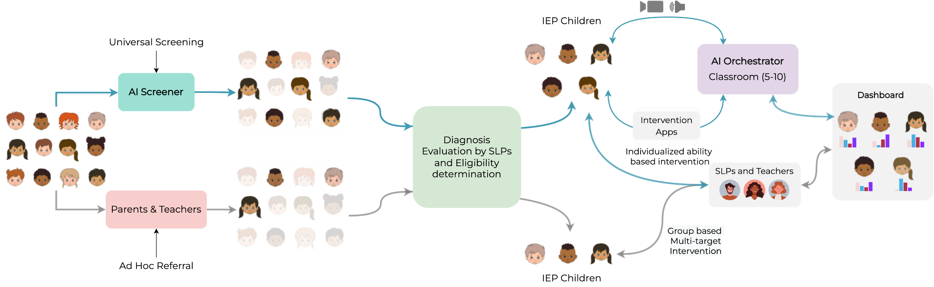




Existing Practices
Evaluation by SLPs and Eligibility
Determination
SLPs & Teachers
Parents &Teachers
Group based
Multi-target
Intervention
Ad Hoc Referral
IEP Children
Children in need may be missed or identified late with ad-hoc referral while lack of individualized intervention produces suboptimal outcomes for all

Slide 12

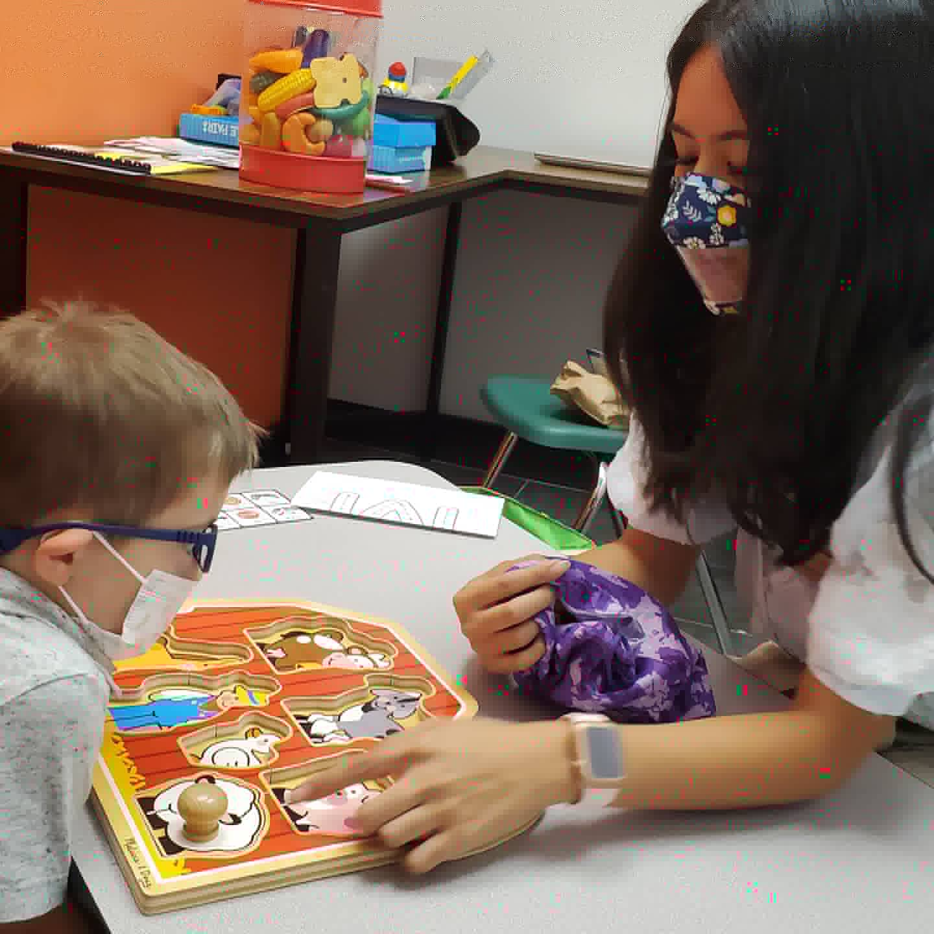
Complexity: choice of custom intervention
IEP Targets
Evidence-Based Intervention Methods
Stimulus Materials
Elicitation Techniques
By the end of the first quarter, the student will:
produce /s/ in the initial position of words at the word level with 80% accuracy (Articulation)
use plural “s" at the word level with 80% accuracy (Language)
decode short “a" sound in CVC (e.g., cat, mat, pat) words with 90% accuracy (Literacy)
use compound sentences to describe a fictional narrative event 4 out of 5 trials (Language/Literacy)
Evidence-based language intervention:
Articulation: discrimination training, imitations, phonetic placement, phonetic shaping, etc.
Language: Expansions (comments that add semantic and syntactic details to incomplete phrases), Focused stimulation (repeat a word or phrase multiple times in a conversation), Explicit teaching of rules
Literacy: decoding and encoding (e.g., phonological awareness), oral reading fluency (e.g., repeated reading, grammar and syntax)
Scaffold needs to consider children’s abilities, and suitability for the context
[ 218 items from one website ]
[https://www.superduperinc.com]

Slide 13
Solving one problem adds to another
If more children are identified, we must provide services
This makes it even harder to provide quality intervention
We need coordinated solutions

Slide 14
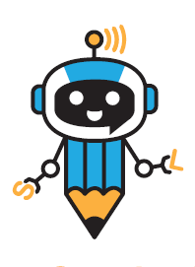







AI Screener and AI Orchestrator
Universal Screening
IEP Children
AI Orchestrator
Classroom (5-10)
Dashboard
AI Screener
Evaluation by SLPs and Eligibility
Determination
Intervention
Apps
Individualized ability
based intervention
SLPs & Teachers
Parents &Teachers
Group based
Multi-target
Intervention
Ad Hoc Referral
IEP Children
Advance use-inspired artificial intelligence (AI) technologies to scale the availability of SLPs for universal screening and individualized ability-based interventions

Slide 15

What is AI...and what is it not?
And how do we leverage it?

Slide 16
What makes AI, AI?
Artificial Intelligence (AI): Systems capable of tasks that typically require human intelligence.
Ex: learning from experience, and understanding natural language
Traditional Computer Programs: Follow predefined rules and instructions to perform specific tasks.
Generally, don't learn from experiences or adapt to new situations.
Takeaway: The ability to learn and adapt makes something an AI.
Question – Is ChatGPT (Chat-Generative Pre-trained Transformer) an AI?
Answer: Technically, NO.
However, in some experts' views, it can be considered a form of "intelligence" since it's able to generate naturalistic, human-like responses.

Slide 17

How can we train better ML models?
If we taught a computer to learn who Conan O'Brien is...
Unimodal Learning: Just Image – Facial structure, Hair, etc.
Multimodal Learning:
Now what if we combined other aspects of what makes Conan unique?
Image Data: Pictures of Conan O'Brien
+
Audio Data: Recognize Conan O'Brien based on his distinctive voice and laughter.
Text Data: Written descriptions, such as his role as a host, his unique humor style, or how tall he is, etc.
Video Data: Movement, gestures, and expressions which are characteristic during his shows.
Advantages of Multimodal Learning?
Makes our Machine Learning models more robust and better at recognizing Conan
when compared to a unimodal case.

Slide 18
Multimodal Learning: The Game Changer?
- What if we use the technology that is on Siri or Alexa to understand what a child is speaking? That’d be great!
- What if we combine that information with the child’s facial expressions?
This is where multimodal learning comes into play, a state-of-the-art approach that combines different data types, such as audio and visual, for a more holistic understanding.
Automatic Speech Recognition for sentence repetition,
Facial recognition for decoding non-verbal cues, etc.
multimodal learning holds immense potential for comprehensive cognitive development diagnosis.

Slide 19
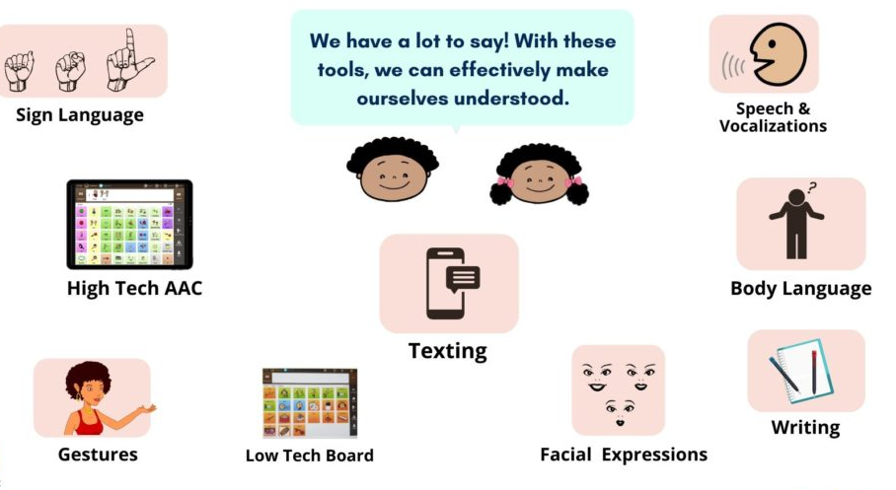
What modalities can we leverage?
Let's say we want to communicate with one another:
In children,
1. Autism Spectrum Disorder: Use video, audio, and text data during play sessions for comprehensive assessment.
2. Stuttering: Use video and audio data to evaluate stutter frequency and reactions.
3. Language Delay: Combine audio, video, and text data to assess language development.
4. Social Communication Disorder: Use audio, video, and text data to understand language use in social contexts.

Slide 20
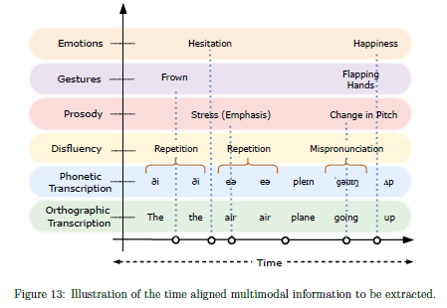
For example…
Plan for multimodal annotation of audio and video
Each modality offers its own challenges

Slide 21
Challenges of AI

Slide 22


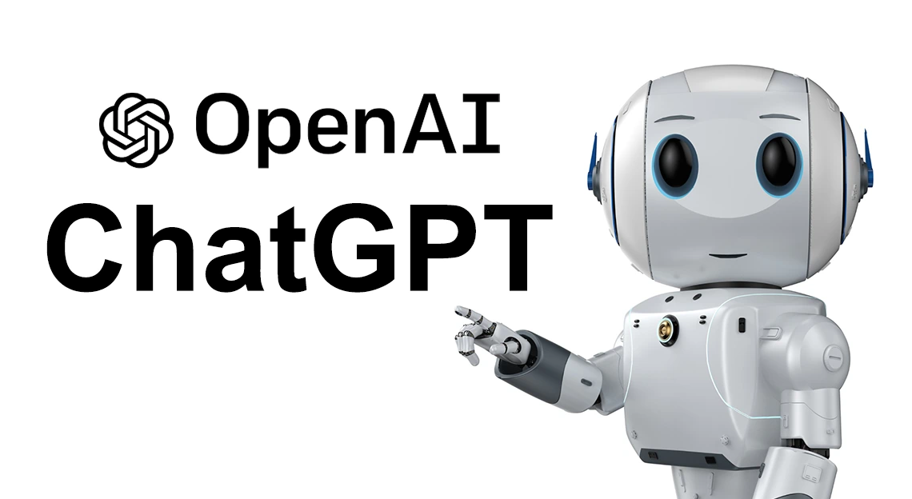

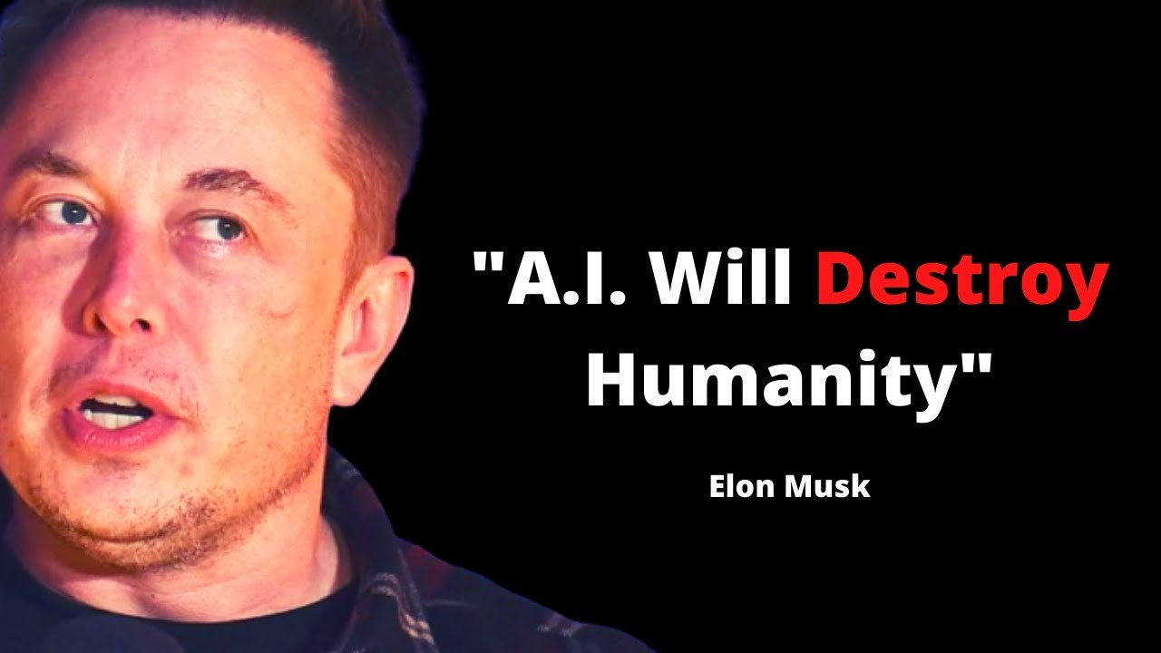


The Elephant In The Room
Why the Panic? Will AI….?
Notes:
Let’s address the elephant in the room. There are public concerns about AI. I am sure you have heard one of the following claims: AI will kill us all, ruin our society, take all our jobs, cause crippling inequality, and enable bad people to do awful things. Much of these claims center on hysterical fear and paranoia due to disruption created by recent Large Language Models like ChatGPT. Look--------Some of it is partially true. Advances in AI, like any other disruptive technology, will make other jobs obsolete, and there is unintended use of this technology. But it will enhance jobs, also create new jobs and can be leveraged for social good, like helping children with speech pathology. However, there will be limitations, such as data, privacy, and security concerns.

Slide 23
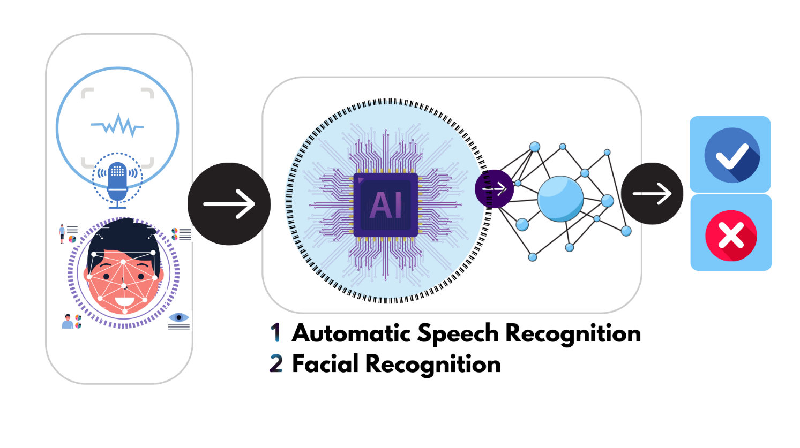
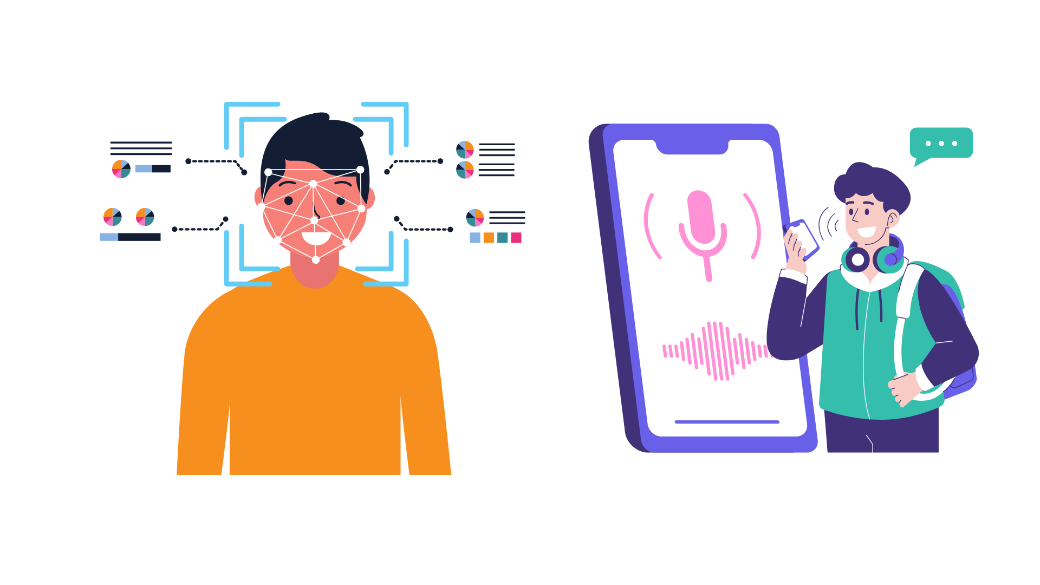
Exploring AI's Boundaries
“Every technology has its limits.”
Children & AI:
Challenges in harnessing AI for children.
Developmental Variability
Diverse Manifestations
Sociolinguistic factors
Ethical Concerns
Limit Data
Higher rates of inaccuracies
.
Notes:
It is essential to recognize that every technology, such as current AI-power systems, have limitations, especially for children, even more so for children challenged with with speech/language pathologies.
Developmental Variability: where Speech patterns evolve with growth.
Diverse Manifestations: where pathologies manifest differently cross-kids
Sociolinguistic factors like language variation, accents amongst the target population
Ethical Concerns: Collecting and using children’s speech data raises privacy and consent issues
Limited Data: There’s a relative scarcity of training data for children’s speech, especially when focusing on various pathologies
Useful tools such as Automatic Speech Recognition and Facial Recognition may exhibit high rates od inaccuracies.

Slide 24

Root Of The Problem
“It's all about the Data!”
The Hunger for Data:
AI's insatiable appetite for large datasets.
Desert of Data:
The struggle with data scarcity
Quest for Quality:
Need data that's not just large but
accurate and representative.
Notes:
Although computational limitations exist, such as working with complex computationally intensive models and the need for real-time processing power devices to process images and voice, data is fundamentally the root of many challenges in this domain.
Obtaining sufficient (large quantity), accurate, and representative data on our target population (children with speech/language pathology) for the development of robust AI tools poses a significant hurdle.

Slide 25
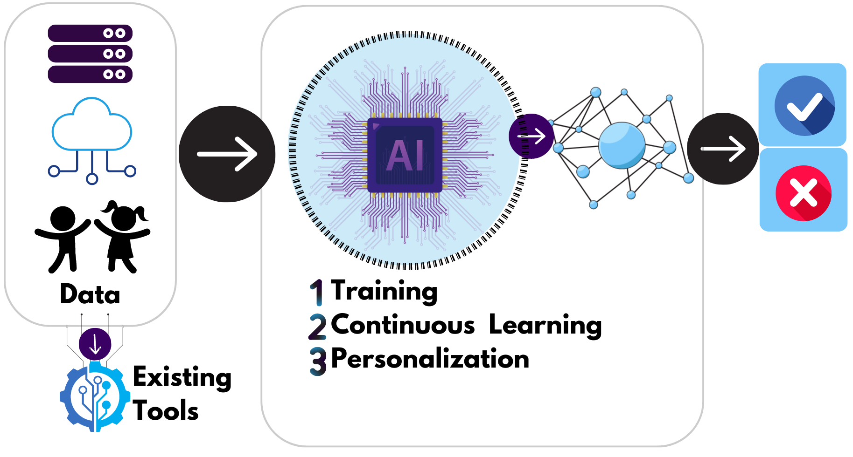
The Centrality of Data in AI
Why is Data Pivotal?
Core foundation for AI's success
AI models & tools thrive on quality data
Notes:
Data is pivotal because AI models fundamentally rely on data in the wild and from existing tools for:
Training, where models develop knowledge by learning to identify patterns, validate accuracy, and test performance to make decisions, such as early detection of speech processing pathologies in kids.
Continuous learning, where we refine decisions to better adapt them to changing conditions, downstream tasks, or changing patterns in the data.
Personalization: This involves analyzing data about an individual's behavior or preferences and then using such data to refine and tailor the AI's responses to that particular user.
With Automatic speech recognition, we adopt a pre-train language model such as ChatGPT, but there will be drawbacks in using such a language model

Slide 26
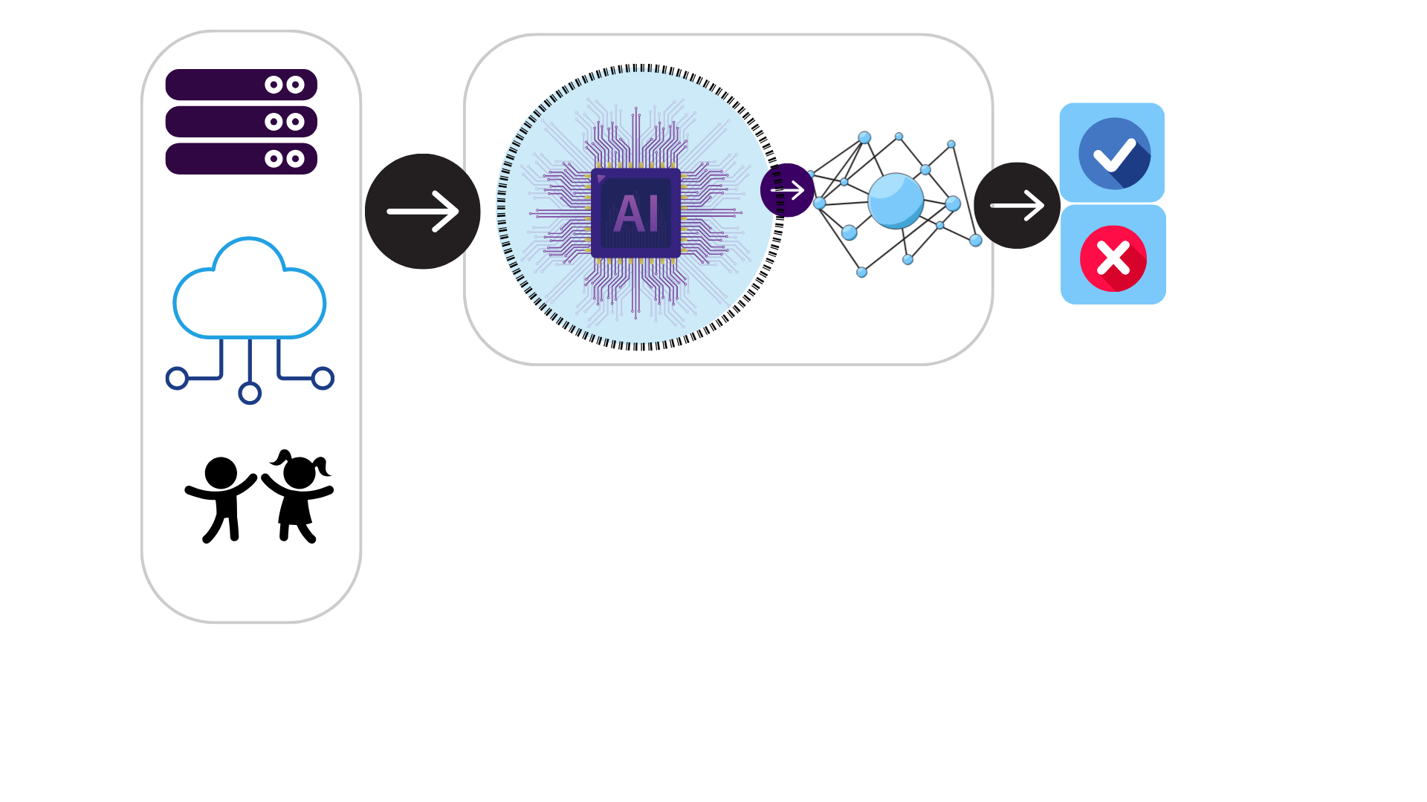
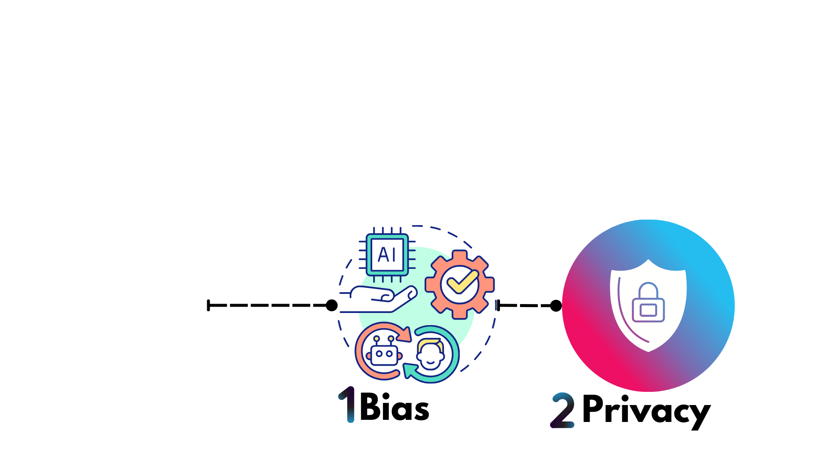
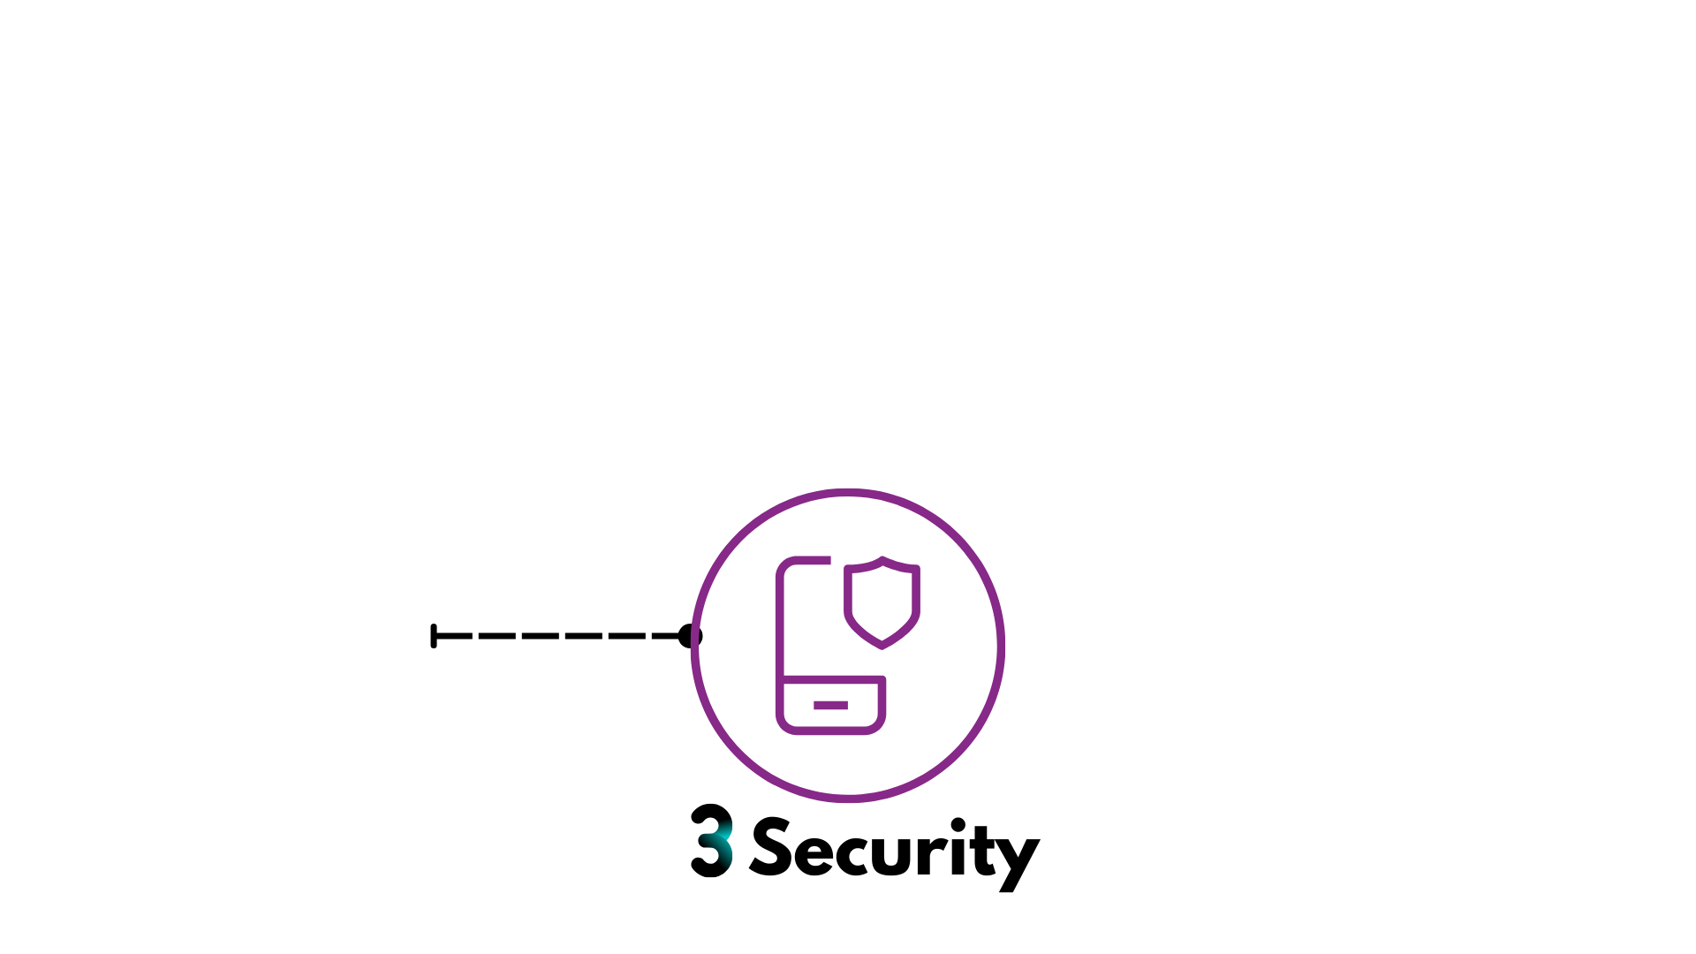

Other Elephants
Critical Concerns
Federated Learning
protect data
Thus, emphasizes
Responsible data use for fairness, privacy & security
Notes:
Data is vital to AI precision and adaptability, but existing datasets can carry biases affecting their precision and adaptability in varied settings.
Reducing these biases is crucial to creating reliable models, especially in early detection systems where minimizing false results is essential.
Ethical or privacy concerns can limit data usage and access.
Securing children's data is subject to laws such as HIPAA and FERPA. This can be avoided with federated Learning, where we can train machine learning models across various devices or servers without centralizing data. Instead, the model is sent to devices to be trained on local data, and only model updates are aggregated to refine the global model.
Inherent biases and privacy risks in data underline the importance of responsible data use to ensure fairness and safeguard privacy.

Slide 27
Take Away “The Elephant”
Current AI technologies face challenges especially with children.
We must balance AI potential with ethical considerations, including data, privacy and security.
We can leverage techniques like Federated Learning to prevent data leakage and prioritize on-device processing.
Notes:
Obtaining accurate and representative data for training AI and developing AI tools for the target population (children with speech/language pathology) is a significant hurdle. Due to the scarcity of such data, we often rely on existing tools and data. However, it is crucial to acknowledge and evaluate the potential consequences of adopting these resources in real-world applications. The inherent biases in available datasets and tools can affect their effectiveness (sensitivity and specificity) and generalization ability (applicability and robustness). Minimizing false negatives and positives is critical in this line of work.
However, it is essential to recognize that current AI technologies have their limitations, especially when dealing with children.
Balancing the promise of AI with ethical considerations, such as data privacy and responsible use, is also crucial as we continue to innovate in this field.
Tackling data leakage through techniques such as Federated Learning – where we use on-device models for inference tasks instead of uploading sensitive data to the cloud for processing.

Slide 28
More about the institute's goals...
“…develop use-inspired AI technologies to help scale the availability of SLPs for early screening and to provide ability-based interventions for young children (3–10 years old) with speech and language related concerns.”
Three foundational AI challenges:
Self-supervised robust learning
Multimodal perception
Multi-agent reinforcement learning

Slide 29
Relating to our discussion of challenges
Self-supervised robust learning
overcome the problem of “small quantities of data that are also noisy”
Multimodal perception
capture the full range of children’s communication
Multi-agent reinforcement learning
learn about and support complex, dynamic human interactions unfolding over time

Slide 30
Human-centered AI design
Using human-centered AI design to keep it useful and ethical.

Slide 31
Wrapping it up

Slide 32
Keys to AI that helps
Design AI solutions that free up SLPs to do what they do best.
Be vigilant to avoid perpetuating bias and inequity.
Involve interested parties in the design process.

Slide 33
Advancing basic science
Major goal is to improve services for children
We can also advance the science of learning to better understand the nature of language disabilities.
Can multimodal analyses that measure automaticity and effort give us insights into language in the child’s mind?
Can AI-generated modifications, like enriched text and personalized practice sessions, help us pinpoint areas of vulnerability?

Slide 34
Learn more about…
National AI Institute for Exceptional Education
ai4exceptionaled.org
Linguistic Diversity Across the Lifespan (training grant)
lindiv.la.psu.edu

Slide 35
Thank you! Questions?

